Slide 1
W4111 – Introduction to Databases Section 002 Spring 2026 Lecture 1: Introduction, Overview, Concepts
COMSW4111_2025_3_003-Introduction-Overview-Concepts © Donald F. Ferguson, 2025
1

Slide 2
Waitlists and Enrollments
Faculty do not manage waitlists for some courses, including W4111.
The academic admin staff in the CS Department manages the waitlist, priorities and enrollment.
You should contact advising email:
ug-advising@cs.columbia.edu, ms-advising @cs.columbia.edu or phd-advising @cs.columbia.edu

Slide 3
Contents

Slide 4
Contents
Course overview:
What you really care about – homework, exams, grading
About your instructor and teaching assistants
Course overview and objectives
Approach to lectures and reading material
Student resources and environment
Introduction: Data, Databases, Database Management Systems
Some basic concepts: data, database, database management system
Classification of data
Concepts
Entity Relationship Model, Entity Relationship Diagrams
Foundational Relational Model and Algebra
Relational Database Management Systems and Structured Query Language
Homework assignments HW0 and HW 1

Slide 5
Course Overview

Slide 6
Homework, Exams, Grading, Attendance

Slide 7
Homework and Grading
Overview
The course grade will be in the range 0 to 100.
The mean/median grade will be approximately a B+, using the standard mapping of numerical value to letter grade. That is, 87 to 89 points is a B+.
I will “curve up” if necessary. I will not curve down.
Point value:
HW1, HW2, …, HW5 are each worth 5 points.
Exams:
There will be 3 non-cumulative online exams using Proctorio.
You must complete each exam in a single, 1 hour and 20 minute session.
You will have approximately one week from exam assignment to take the exam.
The current exam dates are: 20-February, 27-March, 01-May.
Additional information:
A homework will have written questions and practical implementation tasks. The tasks incrementally implement a small project.
Completing and understanding the homework assignments without using ChatGPT, etc. will significantly improve your performance on the exams.

Slide 8
Thoughts on ChatGPT and Generative AI
I used to only give homework and take-home exams.
ChatGPT and generative AI force faculty to fundamentally change the approach to homework and exams.
Some students will use generative AI for take home assignments and take-home exams.
These students will not learn, internalize and understand how to apply the concepts of this course.
Their having ChatGPT do the homework and exams is unfair to students that do the work themselves.
There is a long, long history of tools to increase productivity.
I use generative AI to make me more productive for SW development, presentations, documents, spreadsheets, … … I also use generative AI to help me learn a new domain.
But, I must understand the material and domain
To define the overall project structure, tasks, convert vague requirements to a concrete design, form the prompts, … …
To validate and “tinker with” the generated results.
Generative AI and ChatGPT is about 97% accurate on homework assignments and exam problems. But, 97% accuracy on
Writing an accounting, reporting and compliance application ➔ bankruptcy and/or jail.
Computing optimal parameters for jet engine design from data ➔ unscheduled, rapid disassembly.
Using a database to maintain patient medication records ➔ dead patients.
➔ I must teach you and you must learn the material, or this course is a waste of our time.
Doing the homework assignments without over reliance on generative AI will significantly, significantly improve your performance on exams.

Slide 9
Lectures and Attendance
I will stream and record lectures.
I recommend in-person attendance to lectures and assign extra-credit for regular attendance.
I do use the logs from CourseWorks/Zoom to see which students regularly watch the lectures or the recordings.
Why do I record lectures?
There will be times this semester when I have a compelling reason for not being in-person. If I cannot always be in person, I cannot expect that you will.
There will be times when you have a compelling reason.
Why should you attend?
My total commute time to teach in person is approximately 3 hours. ➔ Basic decency and respect means you should make the effort to attend.
I sometimes answer student questions by using the chalkboard, which will not show up in the lecture stream and recording.
The capacity of the classrooms determines the allowed enrollment in W4111. There are disappointed students that cannot enroll because you are in “their chair.”

Slide 10
Instructor and TAs

Slide 11

About Your Instructor
40 years in computer science industry:
IBM Fellow.
Microsoft Technical Fellow.
Chief Technology Officer, CA technologies.
Dell Senior Technical Fellow.
CTO, Co-Founder, Seeka.tv.
Ansys (Synopsys) (current):
Ansys/Synopsys Fellow, Chief SW Architect;
VP Cloud, AI, Solutions and Developer Enablement BU (CASEBU)
Academic experience:
BA, MS, Ph.D., Computer Science, Columbia University.
Approx. 25 semesters as an Adjunct Professor.
Professor of Professional Practice in CS (2018)
Courses:
E1006: Intro. to Computing
W4111: Intro. to Databases
E6998, E6156: Advanced Topics in SW Engineering (Cloud Computing)
Approx. 65 technical publications; Approx. 12 patents.
Personal:
Two children:
College Sophomore.
2019 Barnard Graduate.
Hobbies:
Krav Maga, Black Belt in Kenpo Karate.
Former 1LT, New York Guard.
Bicycling.
Astronomy.
Languages:
Proficient in Spanish.
Learning Arabic.
I have taught some version of this class 12 times.

Slide 12
About Your TAs
All the TAs have either taken databases with me, previously been a TA for databases, or have industry experience. They can relate to your experience in the class and help you be successful.
I ask them to be your advocates. For example,
Based on their feedback last fall,
I decreased the length of the final exam by 40%.
If you are struggling, please contact them and/or me.
The TAs: I will publish the info about themselves and office hours.

Slide 13
Course Overview, Objectives and Content

Slide 14
The Course
From the new/pending Columbia University Bulletin "Prerequisites: COMS W3134, COMS W3136, or COMS W3137; or the instructor's permission. The course covers what a database system is, how to design databases effectively and in a principled manner, how to query databases, and how to develop applications using databases: entity-relationship modeling, logical design of relational databases, relational algebra, SQL, database application development, database security, and an overview of query optimization and transaction processing. Additional topics generally include NoSQL, graph, object-relational, and cloud databases, as well as data preparation and cleaning of real-world data. The course offers both programming and non-programming paths for homework and projects, to accommodate students with different programming skills and backgrounds."
Prerequisites:
COMS W3134, COMS W3136, or COMS W3137 are data structures classes. All of these courses require extensive programming, in Java.
A course in data structures is helpful for this section of W4111 but not essential. I waive the requirement.
We will help you with any data structures knowledge you lack.
Programming in/for this class:
There will be a "non-programming" option, which we will discuss below.
For students who want to take the programming track, we will use Python. I will provide motivation for choosing Python below.
All students will have to do a little Python programming.

Slide 15
Course Objectives
Have fun, learn a lot and come to appreciate and enjoy some amazing technology. Data and databases have and will change the world.
Provide a foundation that allows you to succeed in future courses. This is an introduction to databases. The technology is crucial for future courses
Big data, data analysis, data science
Advanced database classes
Machine learning
Numerical and data analytics in operations research, engineering, economics, finance, life sciences, financial engineering, medicine, etc.
Enable you to successfully apply the technology in your work and profession.
Have cool stuff to talk about on interviews and in your resumes.

Slide 16
The Course – Value and my Perspective
Database, database application, etc. skills are increasingly central to many disciplines, including:
Economics.
IEOR, financial engineering.
Mechanical and electrical engineering.
Medicine, pharmaceuticals
...
University courses on databases sometimes focus on theory and abstract concepts. This course will cover theory, but there will be an increased emphasis on:
Practical, hands-on applications of databases.
Patterns and best practices.
Developing and understanding database centric applications.
Using databases and various tools for data analysis, visualization and insight.
Personal perspective
A large percent of my career has been spent figuring out or leading teams that figured out how to model, implement and manipulate data.
I have used the information in this class more than anything else I have learned.
This will likely be true for you.
This course is foundational, and will teach you the core concepts in
Data modeling
Data model implementation; Data manipulation.
Different database models and database management systems.
Implementation and architecture of data centric applications and database management systems.
ANY non-trivial application
Requires a well-designed data model.
Implements a data model and manipulates data.
Uses a database management system.
Understanding databases and database management is core to the “hottest fields” in computer science, e.g.
Data science
Machine learning
Intelligent (Autonomous) systems
Internet-of-Things
Cybersecurity
Cloud Computing

Slide 17
Surprising Example
Example: This is a photo of me using a database during COVID-19 mobilization.
Match service members
To JTF-HQ requests for personnel
Based on assignment needs
And service member
Skills
Availability
Tracked in a DBMS.
The hardhat is because DB usage can be very dangerous 😱.
No joking: I had to build an application that used
Relational DBMS.
Python, Jupyter Notebook.
Google Sheets with Apps Script.
Google Forms.
This course’s technology and these skills are surprisingly applicable.

Slide 18
To Program or Not To Program, ...
From the department's guidance for the course:
"To accommodate the diverse backgrounds of the students who take this class, all sections of the class should include a non-programming option for projects and assignments. We (NOTE: Does not include me) have successfully offered such an option in some sections of the class for many years: students can either program a web application to interface with a DB of their own design, or alternatively follow the non-programming option and come up with a quantifiably more detailed DB design/data.
What does not constitute programming?
“Writing queries for a relational, graph, document, or other data management system does not constitute programming and can be expected of all students.
What constitutes programming?”
“Reading more than a handful (1-5) lines of code, Writing Python code that is not directly required to write a query."
Why I previous only did a programming track:
Any non-trivial use of data and databases in any field requires programming. This is not Star Trek. You cannot shout, "Computer! Analyze ..."
You might think, "But, I do not want to program. I want to go into financial services, private equity, medicine, ... I can just use tools like Pandas or Tableau”. You will do some programming in these jobs for complex scenarios. Get over it.
Tracks: Programming and non-programming.
There is a common core that involves understanding concepts, modeling data, using databases, etc.
Exams are the same for both tracks.
Homework assignments: There is a common core on all assignments for both tracks. Additionally,
Programming track will incrementally build a database centric, cloud-based web application.
Non-programming track will do a more complex, database/data engineering centric project.

Slide 19
Technology Used

Slide 20
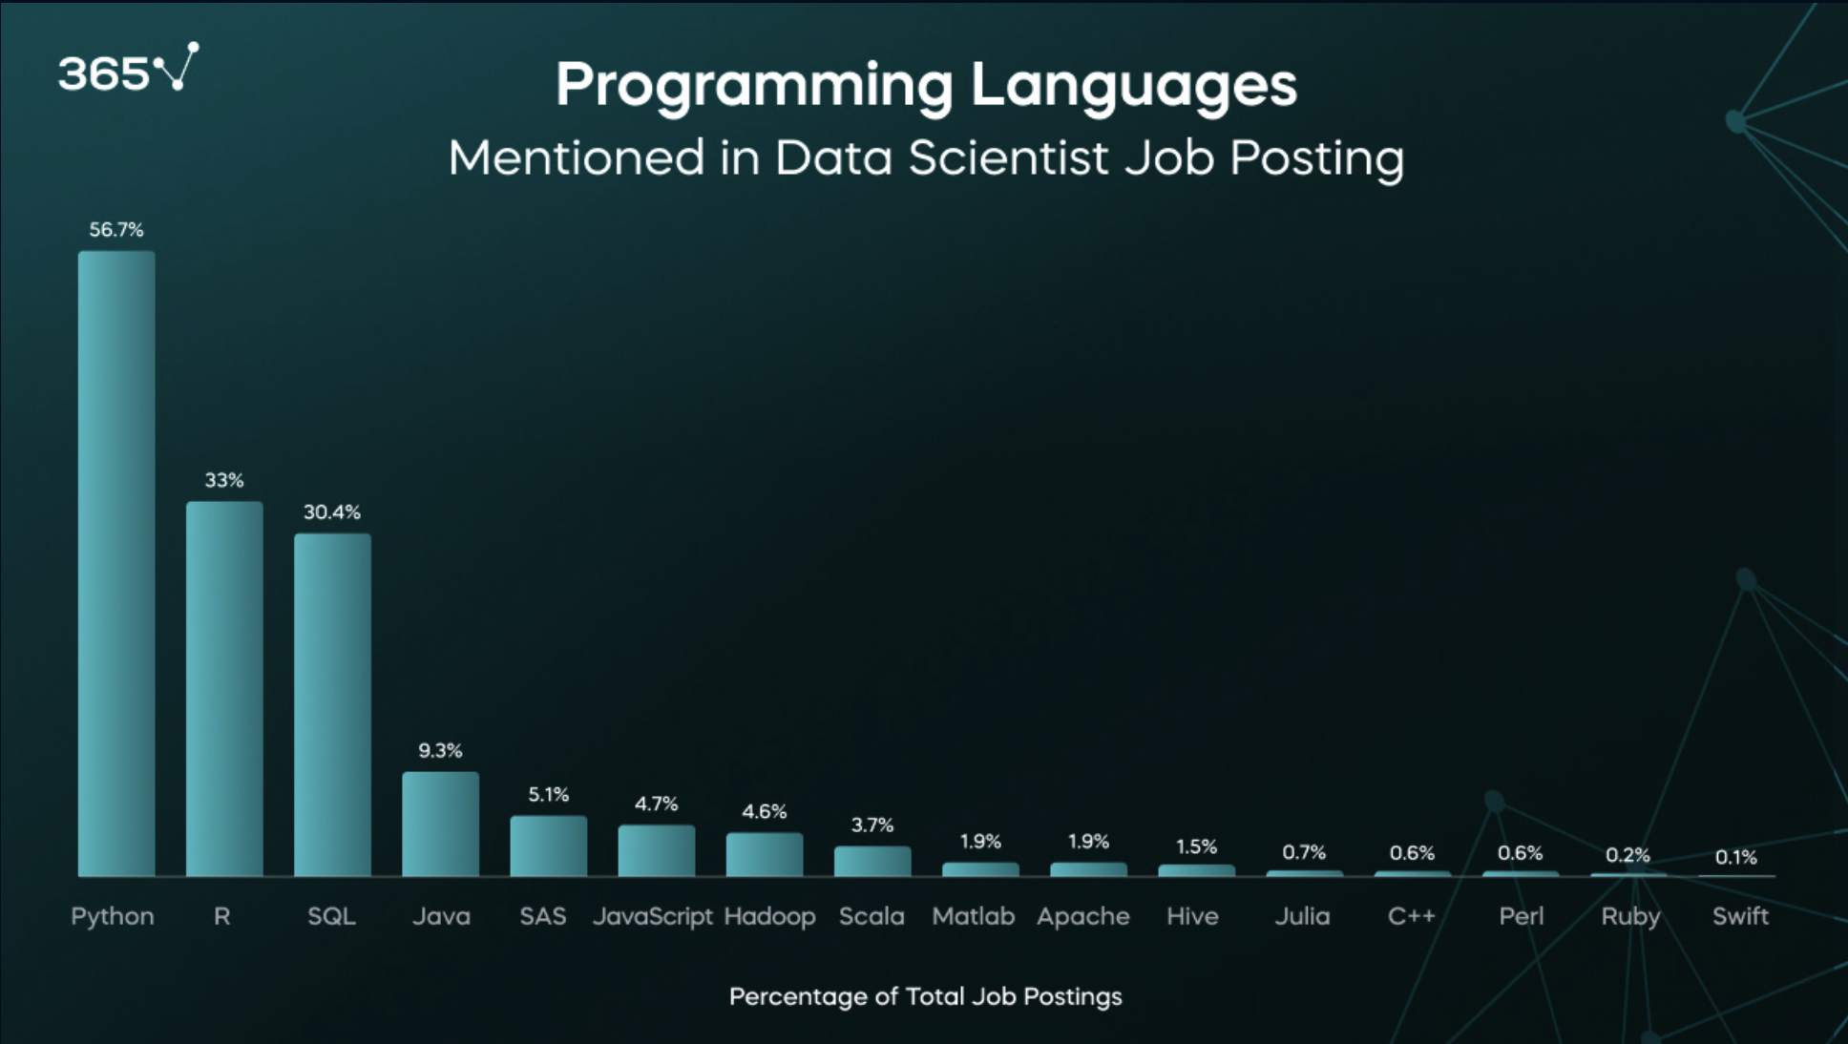
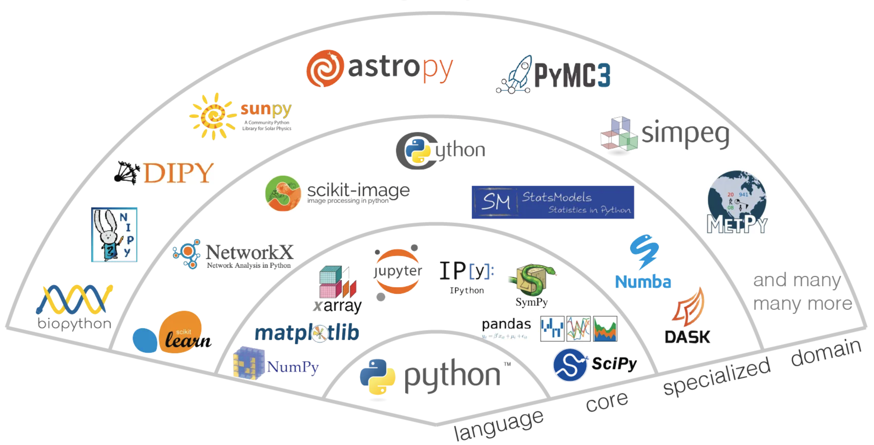
Why Python?
We use Python and the python ecosystem despite the fact that the bulletin says/used to say Java, and many intro. courses are in Java.
Most popular language in data engineering/data science, mathematics and DB, data engineering for AI, … …
Excellent packages, libraries and DB usage examples and tutorials.

Slide 21
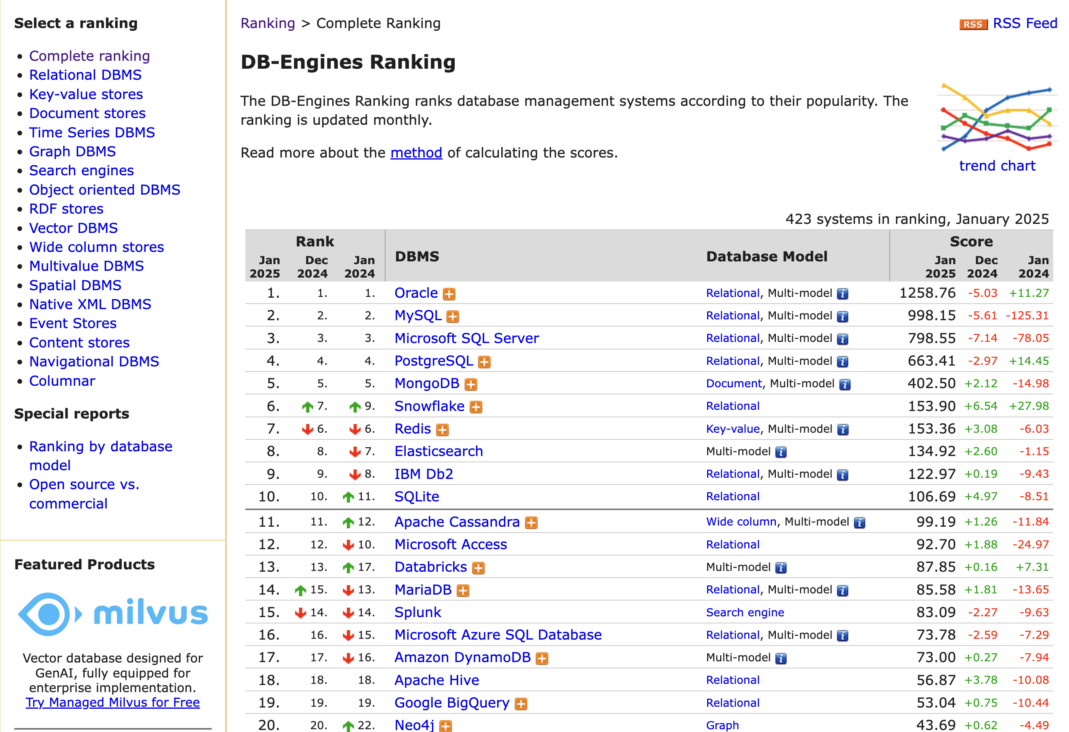
Which Databases?
We will use 4 specific database management/engineering systems: MySQL, MongoDB, PySpark and Neo4j.
My SQL is the most popular “open source, free” relational/SQL DBMS, but PostgreSQL is growing the fastest.
MongoDB is the most popular document DBMS.
Neo4j is the most popular Graph DBMS.
There are many technologies for data engineering and big data. PySpark is popular, common to many systems, simple to install and use from Python.
Note: Vector databases are growing rapidly because of generative AI/LLMs.

Slide 22
Approach to Lectures and Material

Slide 23
Modules
Each section of W4111 is slightly different based on student interest and professor's focus. There is a common, core syllabus. Professors cover topics in different orders and grouping based on teaching style.
This section of W4111 has four modules:
Foundational concepts (50% of semester): This module covers concepts like data models, relational model, relational databases and applications, schema, normalization, … The module focuses on the relational model and relational databases. The concepts are critical and foundational for all types of databases and data centric applications.
Database management system architecture and implementation (10%): This module covers the software architecture, algorithms and implementation techniques that allow databases management systems to deliver functions. Topics include memory hierarchy, storage systems, caching/buffer pools, indexes, query processing, query optimization, transaction processing, isolation and concurrency control.
NoSQL – “Not Only SQL” databases (20%): This module provides motivation for “NoSQL” data models and databases, and covers examples and use cases. The module also includes cloud databases and databases-as-a-service.
Data Enabled Decision Support (20%): This module covers data warehouses, data import and cleanse, OLAP, Pivot Tables, Star Schema, reporting and visualization, and provides and overview of analysis techniques, e.g. clustering, classification, analysis, mining.

Slide 24
Approach to Lectures; Material
Material
The primary source of information needed for homework, exams and learning is the lecture and supporting slides/presentation, including slides I do not present/skip.
There is a recommended textbook, but you can get by with material from the presentations supporting the lectures. (https://www.db-book.com/slides-dir/index.html). I may ask you to read and know material from the book slides. I will identify the material.
Lectures
The format will include a 10-minute break around 11:30.
The material I use will be a presentation and a sometimes Jupyter Notebook with examples.
I am tired of students not coming to lecture, not watching recordings, and then asking questions that I answered or explained in class.
I expect you to attend lecture or watch the recordings.
I may periodically take attendance for extra-credit.
The standard syllabus presents some material sequentially: ER Model → Relational Model → Relational Algebra → SQL
I incrementally cover all topics in increasing detail in the early lectures.

Slide 25
Resources and Environment

Slide 26
Course Resources and Development Environment
Recommended textbook:
Database System Concepts. Seventh Edition. (ISBN 9780078022159)
There is a website associated with the textbook: https://www.db-book.com/. The site has:
Slides for each chapter.
Example data.
Textbooks are expensive. You can easily get through the course using website, lecture material, ... ...
This is a a GitHub repository, GitHub pages and example project for the course:
https://github.com/donald-f-ferguson/W4111-Intro-to-Databases-Spring-2026
You should clone this repository,
There may be individual repositories for some homework assignments.
Paart of HW1 sets up your laptop/PC/Mac for the course.
It explains how to install Git, Jupyter Notebook, PyCharm, DataGrip, MySQL Sever Community Edition. It tests the environment. HW0 is submitting the tests to show you set it up.
There will be a recorded recitation (This weekend).

Slide 27
An overview of data and database concepts

Slide 28
Basic Concepts and Background

Slide 29
What is a Database
This course is COMS W4111 – Introduction to Databases.
Most of us understand what data is.
But, “What is a database?”

Slide 30
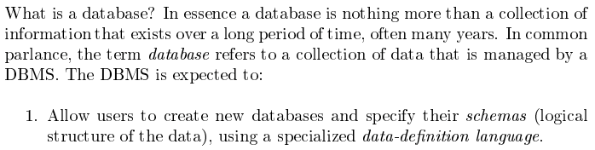
Database Management System (DBMS)
Database Systems: The Complete Book (2nd Edition) by Hector Garcia-Molina (Author), Jeffrey D. Ullman (Author), Jennifer Widom (Author)

Slide 31
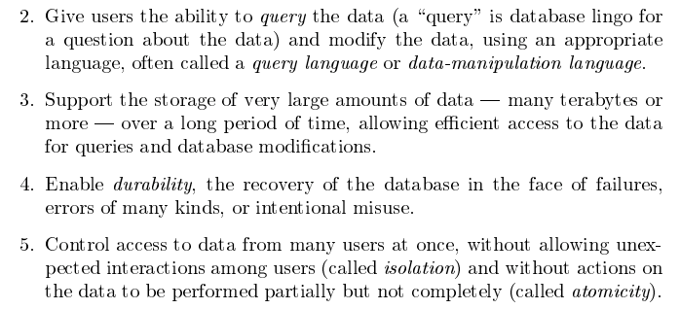
Database Management System (DBMS)
Database Systems: The Complete Book (2nd Edition) by Hector Garcia-Molina (Author), Jeffrey D. Ullman (Author), Jennifer Widom (Author)

Slide 32
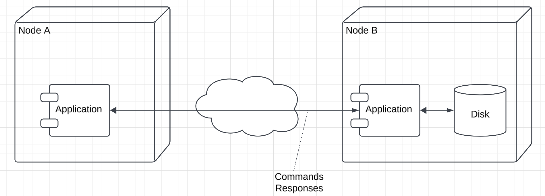
A DBMS is a Special Program
DBMS
Note: Show: DataGrip, mysqld, /usr/local/mysql, /usr/local/mysql/data
This is all “local,” i.e. Node A and Node B are the same and my Mac
We will use DBMS and see examples where the client application and DBMS are on separate nodes.

Slide 33
Outline
When you see a slide formatted this way, it is directly copied from the slides associated with the recommended textbook.
Typically, my comments and annotations, if I added any, are in read text.
Cover this basic material, which you can read is not a good use of lecture time.
I expect you to read the slides and understand the content.
HW1 will check that you understand the material.
Future lectures and HW assume you read and understand the material.
Database-System Applications
Purpose of Database Systems
View of Data
Database Languages
Database Design
Database Engine
Database Architecture
Database Users and Administrators
History of Database Systems
HW 1 requires studying the slides for lecture 1 for the recommended textbook.
https://www.db-book.com/slides-dir/index.html

Slide 34
Some Observations about Data

Slide 35
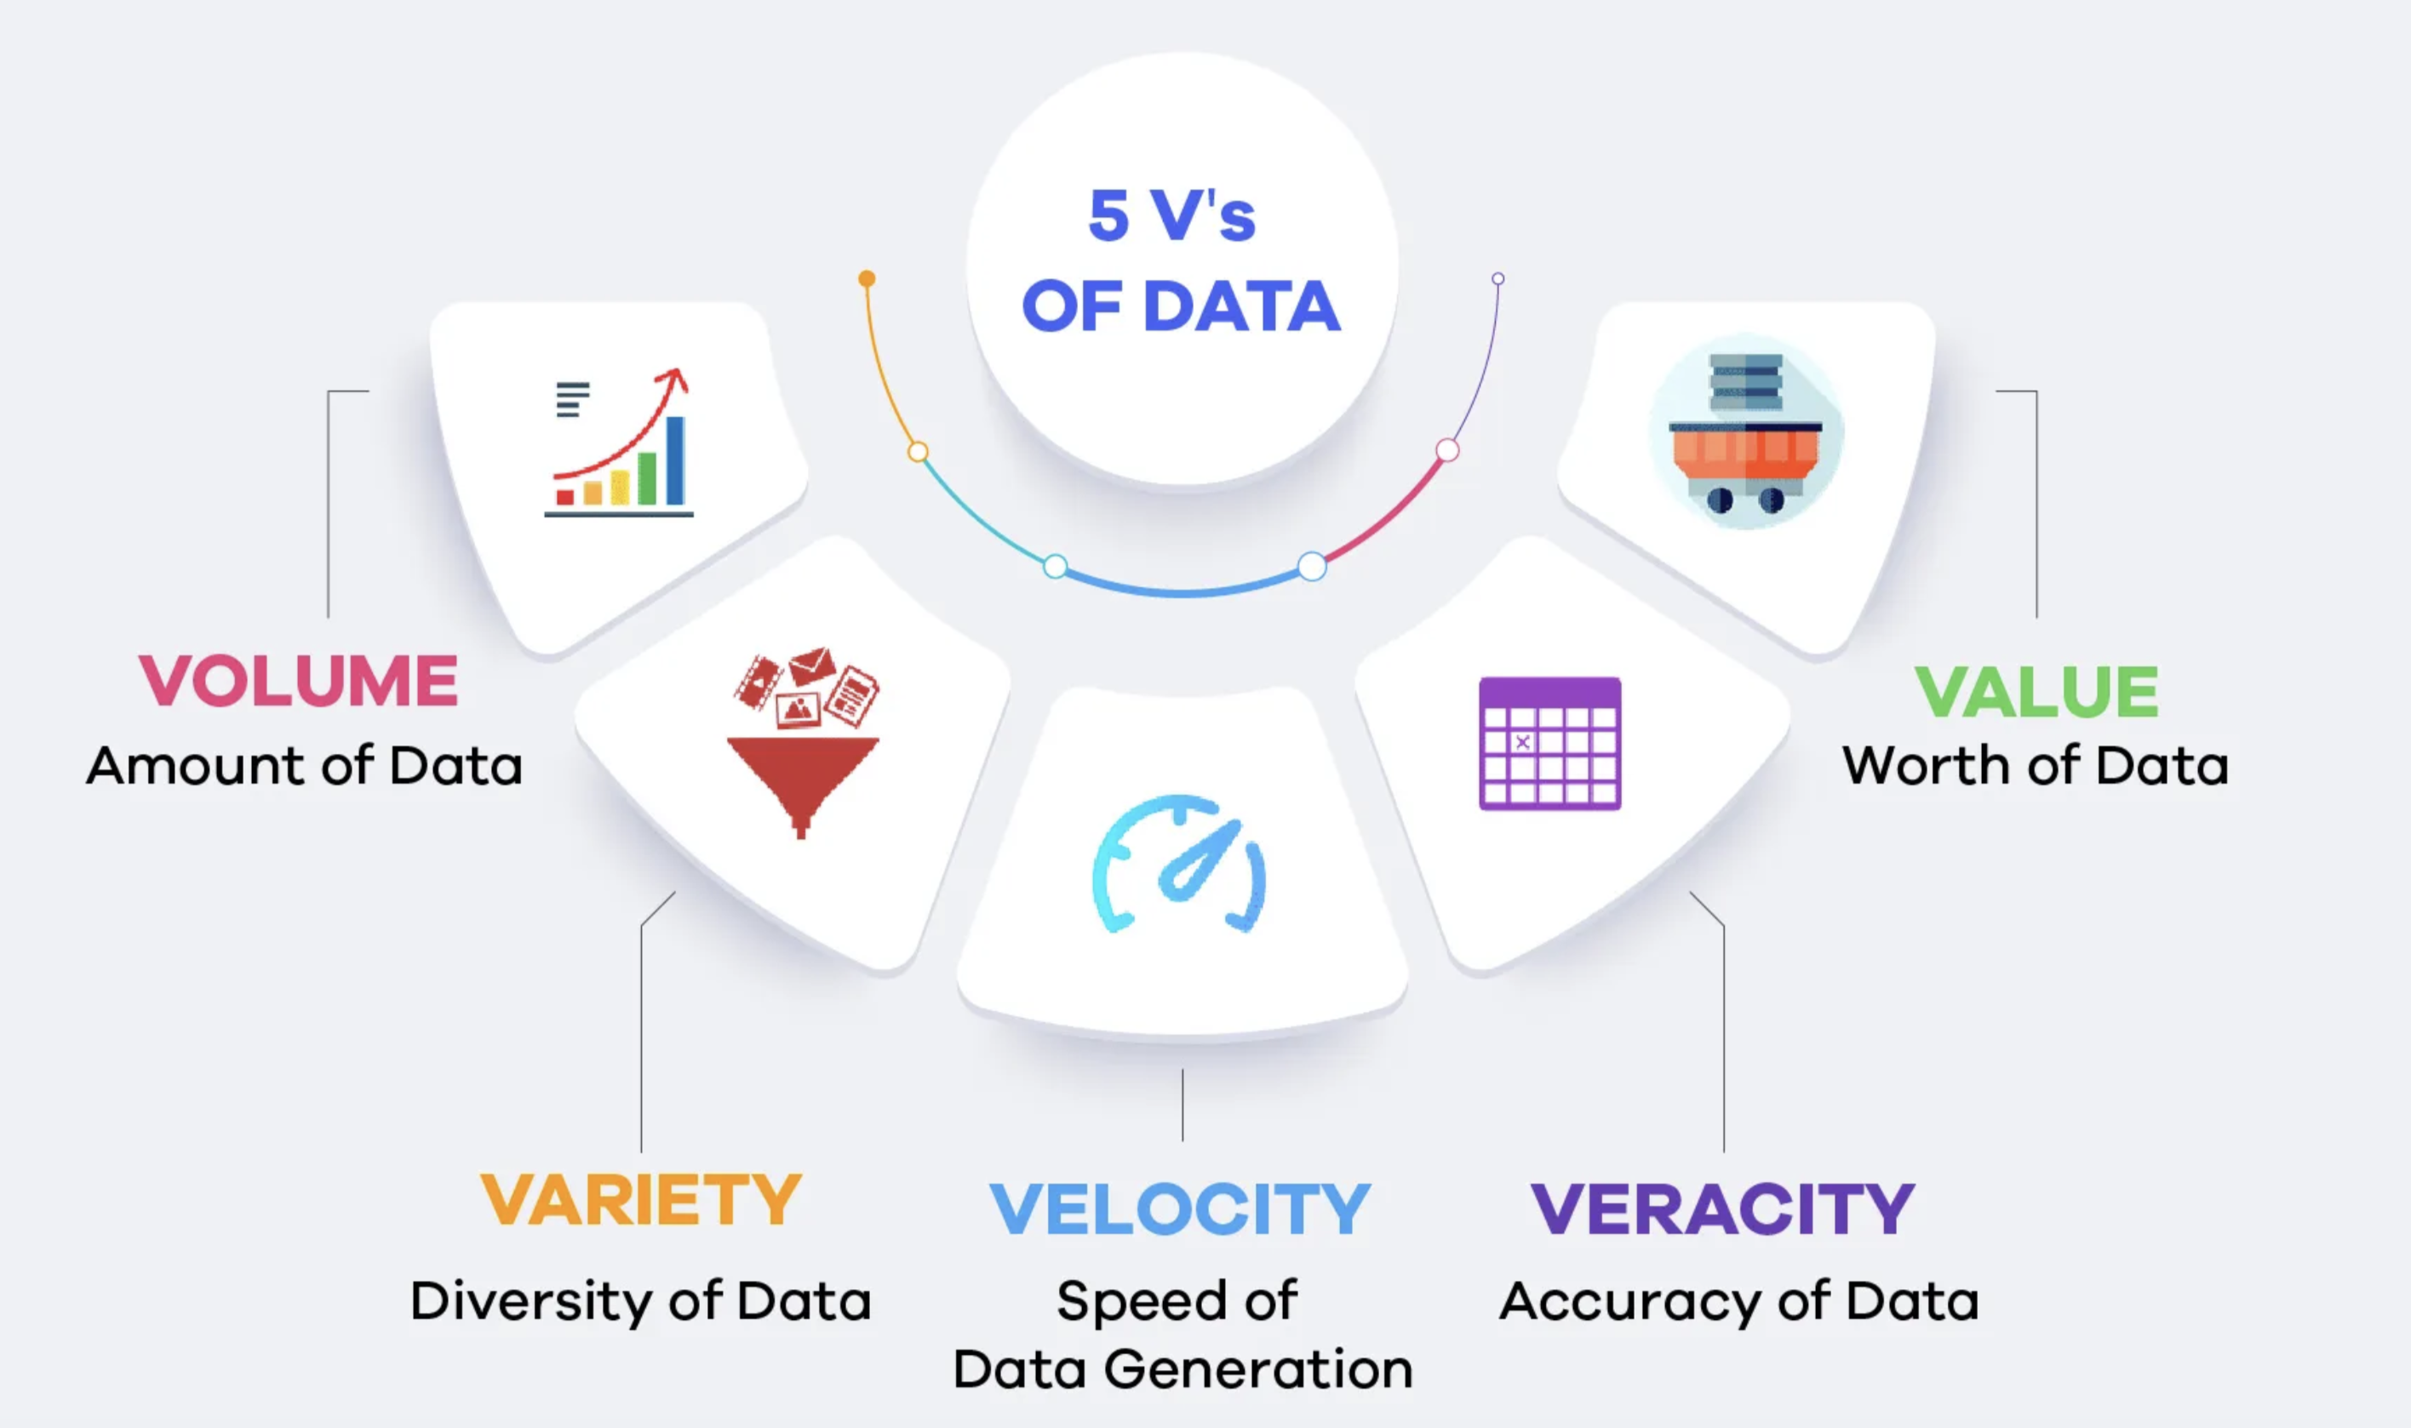
5 Vs of Data

Slide 36
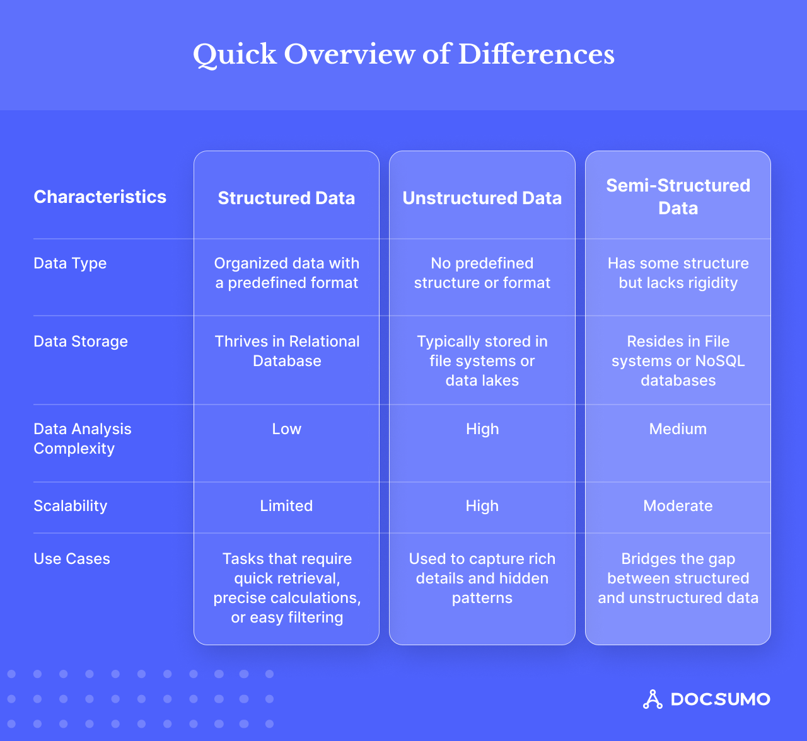
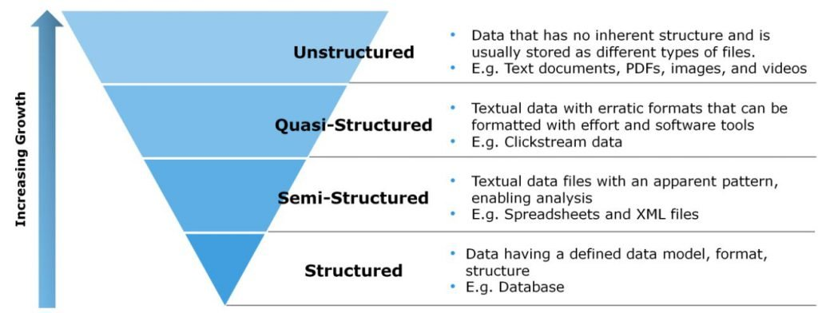
Category of Data
https://www.docsumo.com/blogs/data-extraction/structured-vs-unstructured-vs-semistructured
https://mycloudwiki.com/san/data-and-information-basics/
These are important distinctions, but are not rigorously defined.
The validity constraints you have on data typically determines the “category,” which in turn determines the database product you use.
All categories additionally have metadata, which is usually either structured or semi-structured.

Slide 37
Foundations (1)

Slide 38
ER Model Database Design Modeling

Slide 39
Data Models
A collection of tools for describing
Data
Data relationships
Data semantics
Data constraints
Relational model
Entity-Relationship data model (mainly for database design)
Object-based data models (Object-oriented and Object-relational)
Semi-structured data model (XML)
Other older models:
Network model
Hierarchical model
Notes:
39

Slide 40
Design Phases
Initial phase -- characterize fully the data needs of the prospective database users.
Second phase -- choosing a data model
Applying the concepts of the chosen data model
Translating these requirements into a conceptual schema of the database.
A fully developed conceptual schema indicates the functional requirements of the enterprise.
Describe the kinds of operations (or transactions) that will be performed on the data.
DFF Comments:
We you see slides with this formatting, the come directly from the presentations associated with the textbook. (https://www.db-book.com/db7/slides-dir/index.html)
The number at the bottom is of the form chapter.slide_no.
I try to put my comments, modifications and annotations in red text, or inside a red rectangle/callout.

Slide 41
Design Phases (Cont.)
Final Phase -- Moving from an abstract data model to the implementation of the database
Logical Design – Deciding on the database schema. Database design requires that we find a “good” collection of relation schemas.
Business decision – What attributes should we record in the database?
Computer Science decision – What relation schemas should we have and how should the attributes be distributed among the various relation schemas?
Physical Design – Deciding on the physical layout of the database
Notes:
41

Slide 42

A Common and my Approach: Conceptual → Logical → Physical
https://ehikioya.com/conceptual-logical-physical-database-modeling/
https://www.1keydata.com/datawarehousing/data-modeling-levels.html
It is easy to get carried away with modeling. You can spend all your time modeling and not actually build the schema.
We will use the approaches in class.
Mostly to understand concepts and patterns.
https://www.1keydata.com/datawarehousing/data-modeling-levels.html

Slide 43
ER model -- Database Modeling
The ER data mode was developed to facilitate database design by allowing specification of an enterprise schema that represents the overall logical structure of a database.
The ER data model employs three basic concepts:
entity sets,
relationship sets,
attributes.
The ER model also has an associated diagrammatic representation, the ER diagram, which can express the overall logical structure of a database graphically.

Slide 44
Entity Sets
COMS W4111 002 01 2024
An entity is an object that exists and is distinguishable from other objects.
Example: specific person, company, event, plant
An entity set is a set of entities of the same type that share the same properties.
Example: set of all persons, companies, trees, holidays
An entity is represented by a set of attributes; i.e., descriptive properties possessed by all members of an entity set.
Example:
instructor = (ID, name, salary ) course= (course_id, title, credits)
A subset of the attributes form a primary key of the entity set; i.e., uniquely identifying each member of the set.
DFF Comments:
Some of these statements apply primarily to OO systems and the relational/SQL models.
A motivation for “No SQL” is to relax the constraints.

Slide 45
Entity Sets -- instructor and student
Relationship Set:
{
(10101, 98988),
(10101,76543)
}

Slide 46
Relationship Sets
A relationship is an association among several entities
Example: 44553 (Peltier) advisor 22222 (Einstein) student entity relationship set instructor entity
A relationship set is a mathematical relation among n ≥ 2 entities, each taken from entity sets
{(e₁, e₂, … e_{n}) | e₁ ∈ E₁, e₂ ∈ E₂, …, e_{n} ∈ E_{n}} where (e₁, e₂, …, e_{n}) is a relationship
Example:
(44553,22222) ∈ advisor
DFF Comments:
Nobody thinks about relationships this way.
There is no idea so simple that a DB professor cannot make it confusing, usually by using math.

Slide 47
Relationship Sets (Cont.)
Example: we define the relationship set advisor to denote the associations between students and the instructors who act as their advisors.
Pictorially, we draw a line between related entities.
DFF Comment:
In this diagram, the lines are the relationship set.
Many DB diagram/models use a 3rd entity set to represent complex relationships.
The relationship set would be: (76766, 98988) (45565, 12345) (45565, 00128) ( …, …)
DFF Comments:
Nobody draws the diagrams this way, but ...
Sometimes thinking this way helps understand other ways to depict the concept.

Slide 48

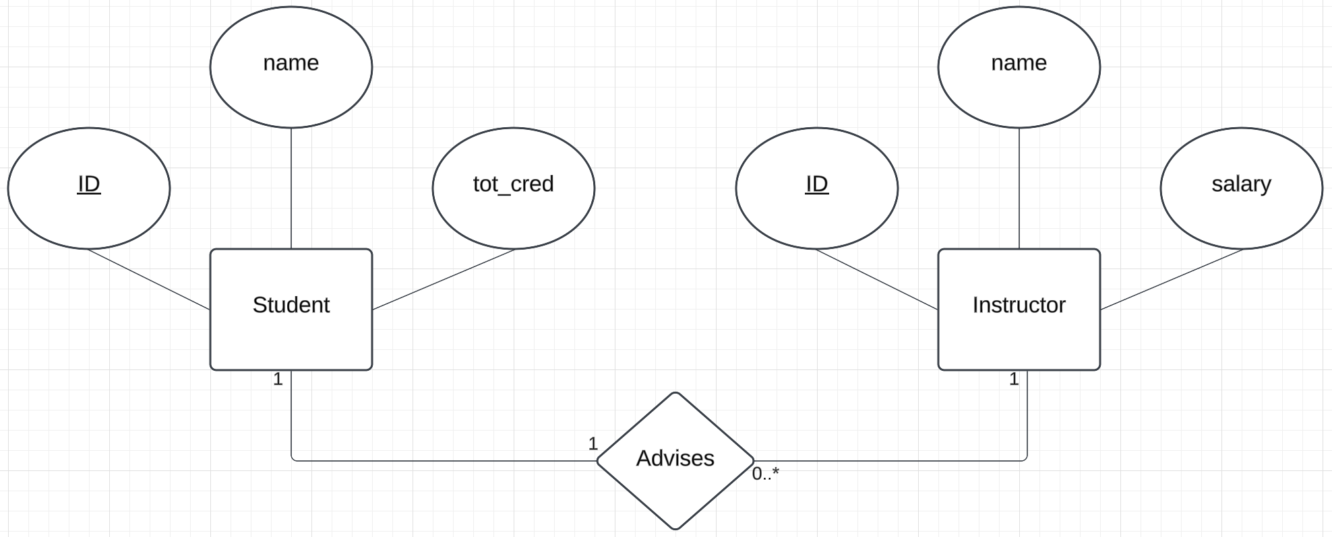
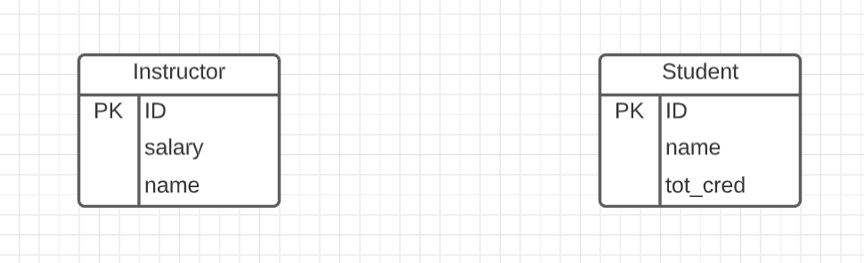
Representing Entity sets in ER Diagram
Entity sets can be represented graphically as follows:
Rectangles represent entity sets.
Attributes listed inside entity rectangle
Underline indicates primary key attributes
“Visual modeling is the use of semantically rich, graphical and textual design notations to capture software designs. A notation, such as UML, allows the level of abstraction to be raised, while maintaining rigorous syntax and semantics. In this way, it improves communication in the design team, as the design is formed and reviewed, allowing the reader to reason about the design, and it provides an unambiguous basis for implementation.”
Book Notation
UML ERD Profile
Crow’s Foot Notation

Slide 49
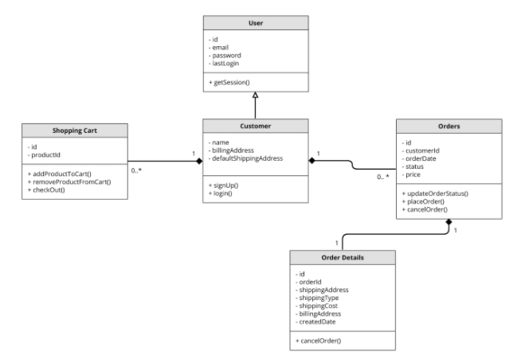
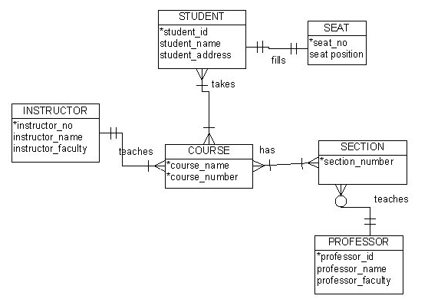
Visual Notation – Many Notations
ER Model
UML
“Other,” i.e. PowerPoint is the most common modeling notation.
It is easy to get “carried away.”
The trick is to do “just enough modeling.”
I mostly use Crow’s Foot
It is “just enough”
But lacks some capabilities.
The book uses ER notation.
Crow’s Foot

Slide 50
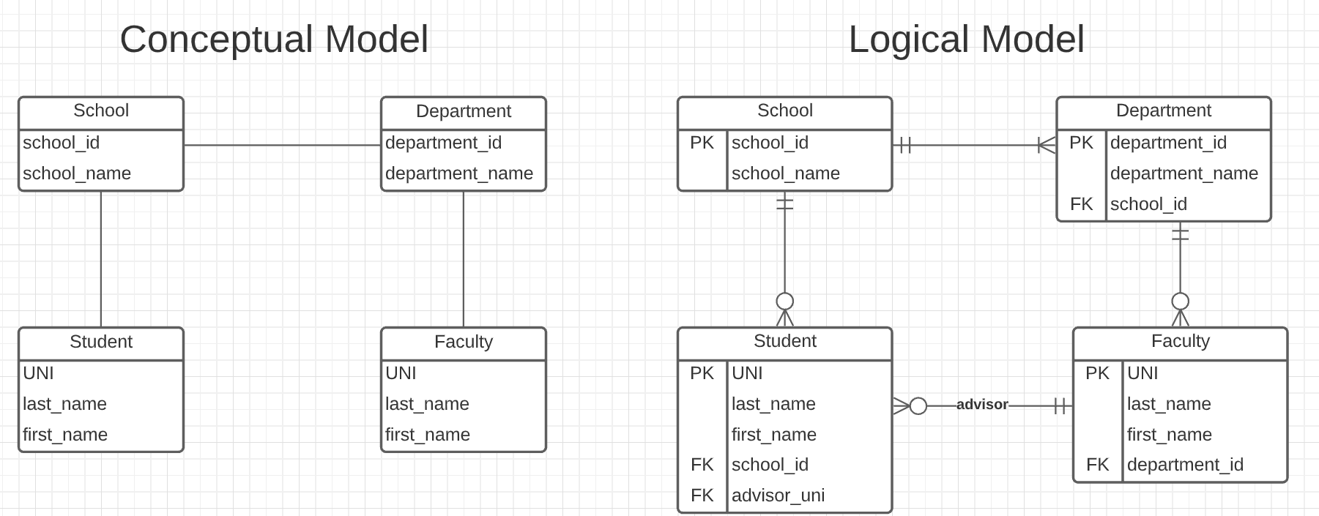
Do a Slightly More complex University Database ER Model
The model has:
Four entity sets:
School
Department
Student
Faculty
Three relationship sets:
Student-School
School-Department
Faculty-Department.
This is the level of detail I want when I ask for:
Conceptual Model diagram.
Logical Model diagram.
Some tools with “free,” constrained usage.
Lucidchart (https://www.lucidchart.com/)
Vertabelo (https://vertabelo.com/)
DrawIO (https://www.drawio.com/)
DFF Note: Demo in Lucidchart

Slide 51
Notation has Precise Meaning
Attribute annotations:
PK = Primary Key
FK = Foreign Key
Line annotations:
We will learn over time and there are good tutorials (https://www.lucidchart.com/pages/er-diagrams) to help study and refresh.
We will spend a lot of time discussing keys.
We will start in a couple of slides.

Slide 52
Relational Model Relational Algebra

Slide 53


Relational Model
All the data is stored in various tables.
Example of tabular data in the relational model
Columns
Ted Codd Turing Award 1981
The “relation” is the “table.”
In my big space of pieces of data. ID, name, dept_name, salary are somehow related.
This causes confusion, because the ER and other models use “relation” to mean something else.
Core concepts:
Relation
Tuple (Row)
Column (Attribute)
Rows
Notes:
53

Slide 54

Example of a Instructor Relation
attributes
(or columns)
tuples
(or rows)

Slide 55
Attribute
The set of allowed values for each attribute is called the domain of the attribute
Attribute values are (normally) required to be atomic; that is, indivisible
The special value null is a member of every domain. Indicated that the value is “unknown”
The null value causes complications in the definition of many operations
DFF Comments:
I will explain the importance of atomic attributes and null in examples.
Atomic and use of Null is important!

Slide 56
Domain, Atomic and NULL
A domain is a data type and rules/constraints on allowed values.
Email is type text and must contain the character “@”
Social Security number is type text(9) and can only contain ‘0’, ‘1’, … …, ‘9’
A domain is atomic if it cannot be broken down into a set of more basic domains
The domain name of the form “Ferguson, Donald, F” is not atomic. It is three domains: lastname, firstname, middle initial.
The domain course ID of the form COMSW4111 is not atomic:
COMS is from the domain department.
W is from the domain faculty code.
4111 is from the domain valid course numbers.
NULL indicates that a value is not applicable or unknown for the entity.
➔ You cannot use another, ad hoc value like -1 for age or ‘’ for middle initial.
null == null, lastname != null, null > 5 all evaluate to NULL, not TRUE or FALSE.

Slide 57

Relations are Unordered
Order of tuples is irrelevant (tuples may be stored in an arbitrary order)
Example: instructor relation with unordered tuples

Slide 58
Database Schema
Database schema -- is the logical structure of the database.
Database instance -- is a snapshot of the data in the database at a given instant in time.
Example:
schema: instructor (ID, name, dept_name, salary)
Instance:

Slide 59
Keys
Let K ⊆ R
K is a superkey of R if values for K are sufficient to identify a unique tuple of each possible relation r(R)
Example: {ID} and {ID,name} are both superkeys of instructor.
Superkey K is a candidate key if K is minimal Example: {ID} is a candidate key for Instructor
One of the candidate keys is selected to be the primary key.
which one?
Foreign key constraint: Value in one relation must appear in another
Referencing relation
Referenced relation
Example: dept_name in instructor is a foreign key from instructor referencing department

Slide 60
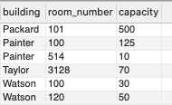
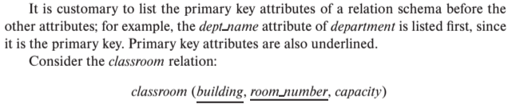
Notation
Classroom relation
classroom schema
Columns (Attributes)
Relation Name
Primary Key Columns
The primary key is a composite key. Neither column is a key (unique) by itself.
Keys are statements about all possible, valid tuples and not just the ones in the relation.
capacity is unique in this specific data, but clearly not unique for all possible data.
In this domain, there cannot be two classrooms with the same building and room number.
Relation schema:
Underline indicates a primary key column. There is no standard way to indicate other types of key.
We will use bold to indicate foreign keys.
You will sometimes see things like classroom(building:string, room_number:number, capacity:number)

Slide 61
Observations
Keys:
Will be baffling. It takes time and experience to understand/appreciate.
There are many, many types of keys with formal definitions.
I explain the formality but focus on the concepts and applications.
No one uses the formal, relational model. So, why do we study it?
Is very helpful when understanding concepts that we cover later in the course, especially query optimization and processing.
There are many realizations of the model and algebra, and understanding the foundation helps with understanding language/engine capabilities.
The model has helped with innovating new approaches, and you may innovate in data and query models in your future.

Slide 62
Relational Query Languages
Procedural versus non-procedural, or declarative
“Pure” languages:
Relational algebra
Tuple relational calculus
Domain relational calculus
The above 3 pure languages are equivalent in computing power
We will concentrate in this chapter on relational algebra
Not turning-machine equivalent
Consists of 6 basic operations

Slide 63
Relational Algebra
A procedural language consisting of a set of operations that take one or two relations as input and produce a new relation as their result.
Six basic operators
select: σ
project: ∏
union: ∪
set difference: –
Cartesian product: x
rename: ρ
DFF Comments:
You will sometimes see other operator, e.g. ← Assignment.
Relational algebra focuses on retrieve. You can sort of do Create, Update, Delete.
The SQL Language, which we will see, extends relational algebra.

Slide 64

Select Operation
The select operation selects tuples that satisfy a given predicate.
Notation: σ _{p} (r)
p is called the selection predicate
Example: select those tuples of the instructor relation where the instructor is in the “Physics” department.
Query
σ _{dept_name=“Physics”} (instructor)
Result

Slide 65
Select Operation (Cont.)
We allow comparisons using
=, ≠, >, ≥. <. ≤
in the selection predicate.
We can combine several predicates into a larger predicate by using the connectives:
∧ (and), ∨ (or), ¬ (not)
Example: Find the instructors in Physics with a salary greater $90,000, we write:
σ _{dept_name=“Physics”} ∧ _{salary} > 90,000 (instructor)
Then select predicate may include comparisons between two attributes.
Example, find all departments whose name is the same as their building name:
σ _{dept_name=building} (department)

Slide 66
Project Operation
A unary operation that returns its argument relation, with certain attributes left out.
Notation:
∏ _{A1,A2,A3 ….Ak} (r)
where A₁, A₂ are attribute names and r is a relation name.
The result is defined as the relation of k columns obtained by erasing the columns that are not listed
Duplicate rows removed from result, since relations are sets

Slide 67

Project Operation (Cont.)
Example: eliminate the dept_name attribute of instructor
Query: ∏_{ID, name, salary} (instructor)
Result:

Slide 68
Composition of Relational Operations
The result of a relational-algebra operation is relation and therefore of relational-algebra operations can be composed together into a relational-algebra expression.
Consider the query -- Find the names of all instructors in the Physics department.
∏_{name}(σ _{dept_name} _{=“Physics”} (instructor))
Instead of giving the name of a relation as the argument of the projection operation, we give an expression that evaluates to a relation.

Slide 69
The Dreaded Relax Calculator
Let’s look at an online tool that you will use.
RelaX (https://dbis-uibk.github.io/relax/calc/local/uibk/local/0)
The calculator:
Has an older version of the data from the recommended textbook. (https://dbis-uibk.github.io/relax/calc/gist/4f7866c17624ca9dfa85ed2482078be8/relax-silberschatz-english.txt/0)
You can also upload new data.
Some queries:
σ dept_name='Comp. Sci.' ∨ dept_name='History' (department)
π name, dept_name (instructor)
π ID, name ( σ dept_name='Comp. Sci.' (instructor) )

Slide 70
SQL

Slide 71
History
IBM Sequel language developed as part of System R project at the IBM San Jose Research Laboratory
Renamed Structured Query Language (SQL)
ANSI and ISO standard SQL:
SQL-86
SQL-89
SQL-92
SQL:1999 (language name became Y2K compliant!)
SQL:2003
Commercial systems offer most, if not all, SQL-92 features, plus varying feature sets from later standards and special proprietary features.
Not all examples here may work on your particular system.

Slide 72
SQL Parts
DML -- provides the ability to query information from the database and to insert tuples into, delete tuples from, and modify tuples in the database.
integrity – the DDL includes commands for specifying integrity constraints.
View definition -- The DDL includes commands for defining views.
Transaction control –includes commands for specifying the beginning and ending of transactions.
Embedded SQL and dynamic SQL -- define how SQL statements can be embedded within general-purpose programming languages.
Authorization – includes commands for specifying access rights to relations and views.

Slide 73
SQL Language Statements
The core SQL language statements are:
SELECT: Implements both σ, π
INSERT
UPDATE
DELETE
CREATE TABLE
ALTER TABLE
JOIN, which is an operator within SELECT.
Many, if not most, SQL statements:
Implement multiple relational algebra expressions.
Cannot easily (or at all) be represented in relational algebra.
π ID, name ( σ dept_name='Comp. Sci.' (instructor) )
=
SELECT ID, name FROM instructor WHERE
dept_name=‘Comp. Sci.’

Slide 74
Basic Query Structure
R1,r2,r3 is an implicit join, which I try to avoid. This basically
form the set
R₁ X R₂ X R₃ where X is the
cartesian product of the 3
relations, which we will see rarely makes sense.
I make the JOIN explicit.
A typical SQL query has the form: select A₁, A₂, ..., A_{n} from r₁, r₂, ..., r_{m} where P
A_{i} represents an attribute
R_{i} represents a relation
P is a predicate.
The result of an SQL query is a relation.
Note:
The SELECT ... FROM ... WHERE ... Combines two relational operators, σ and ∏.
Actually, it also combines other operators, e.g. x
Notes:
2

Slide 75
The select Clause
The select clause lists the attributes desired in the result of a query
corresponds to the projection operation of the relational algebra
Example: find the names of all instructors: select name from instructor
NOTE: SQL names are case insensitive (i.e., you may use upper- or lower-case letters.)
E.g., Name ≡ NAME ≡ name
Some people use upper case wherever we use bold font.
Notes:
3

Slide 76
The select Clause (Cont.)
SQL allows duplicates in relations as well as in query results.
To force the elimination of duplicates, insert the keyword distinct after select.
Find the department names of all instructors, and remove duplicates
select distinct dept_name from instructor
The keyword all specifies that duplicates should not be removed.
select all dept_name from instructor
Notes:
4

Slide 77
The select Clause (Cont.)
An asterisk in the select clause denotes “all attributes”
select * from instructor
An attribute can be a literal with no from clause
select '437'
Results is a table with one column and a single row with value “437”
Can give the column a name using:
select '437' as FOO
An attribute can be a literal with from clause
select 'A' from instructor
Result is a table with one column and N rows (number of tuples in the instructors table), each row with value “A”
Notes:
5

Slide 78
The select Clause (Cont.)
The select clause can contain arithmetic expressions involving the operation, +, –, ∗, and /, and operating on constants or attributes of tuples.
The query:
select ID, name, salary/12 from instructor
would return a relation that is the same as the instructor relation, except that the value of the attribute salary is divided by 12.
Can rename “salary/12” using the as clause:
select ID, name, salary/12 as monthly_salary
Notes:
5

Slide 79
The where Clause
The where clause specifies conditions that the result must satisfy
Corresponds to the selection predicate of the relational algebra.
To find all instructors in Comp. Sci. dept
select name from instructor where dept_name = 'Comp. Sci.'
SQL allows the use of the logical connectives and, or, and not
The operands of the logical connectives can be expressions involving the comparison operators <, <=, >, >=, =, and <>.
Comparisons can be applied to results of arithmetic expressions
To find all instructors in Comp. Sci. dept with salary > 80000
select name from instructor where dept_name = 'Comp. Sci.' and salary > 80000
Notes:
6

Slide 80
The from Clause
The from clause lists the relations involved in the query
Corresponds to the Cartesian product operation of the relational algebra.
Find the Cartesian product instructor X teaches
select ∗ from instructor, teaches
generates every possible instructor – teaches pair, with all attributes from both relations.
For common attributes (e.g., ID), the attributes in the resulting table are renamed using the relation name (e.g., instructor.ID)
Cartesian product not very useful directly, but useful combined with where-clause condition (selection operation in relational algebra).
Notes:
8

Slide 81
Examples
Find the names of all instructors who have taught some course and the course_id
select name, course_id from instructor , teaches where instructor.ID = teaches.ID
Find the names of all instructors in the Art department who have taught some course and the course_id
select name, course_id from instructor , teaches where instructor.ID = teaches.ID and instructor. dept_name = 'Art'
Notes:
9

Slide 82
Data Definition Language
The SQL data-definition language (DDL) allows the specification of information about relations, including:
The schema for each relation.
The type of values associated with each attribute.
The Integrity constraints
The set of indices to be maintained for each relation.
Security and authorization information for each relation.
The physical storage structure of each relation on disk.

Slide 83
Create Table Construct
An SQL relation is defined using the create table command:
create table r
(A₁ D₁, A₂ D₂, ..., A_{n} D_{n}, (integrity-constraint₁), ..., (integrity-constraint_{k}))
r is the name of the relation
each A_{i} is an attribute name in the schema of relation r
D_{i} is the data type of values in the domain of attribute A_{i}
Example:
create table instructor ( ID char(5), name varchar(20), dept_name varchar(20), salary numeric(8,2))

Slide 84
Homework 1

Slide 85
Walk Through the Definition
Ed will contain the details of completion.
HW 1 has three parts:
Demonstrating that you have successfully set up your environment.
Written questions demonstrating your knowledge of the book’s lecture 1 slides’ material.
Some simple, “practical” relational algebra and SQL questions.
HW1
Will come out this weekend.
Is due on 06-February-2026 at 11:59 PM.
The TAs and I will NOT answer setup questions after 30-January.
Will cover content from 23-Jan, and 30-Jan lectures.

